Slide 1
Objectives
To help clients from various small-scale business to recover from crisis and to develop their business. It will have good social impact to encourage entrepreneurs and resolve unemployment opportunities.

Slide 2
Abstract
SAMJPEK is a start-up business consulting firm which gives a prediction for client's business growth.
It is a team of six Business consultants.
Each consultant specializes a particular discipline, including finance, sales and marketing technology and human resources.
This company will upgrade the client's business by understanding the problems and providing innovative solutions for it.
This can be done through prediction.
Prediction can be used to increase customer visits, to increase sales and to overcome competitive companies.
This can be done through many modules and can be performed in SPSS modeler.
It provides information and benefits which are needed by the clients.
It helps the client company to offer more quality service than many of its competitors.

Slide 3
Description of product
To provide business solutions through data analysis and prediction using latest software tools.
Early identification of business problems
Providing solutions through data analysis and based on client's needs.
Identification of customer requirements through data analysis.
Modeling stream consists of many classification algorithms such as C5.0 node, Regression, Apriori, Feature selection and some graphs.
Finding age-wise distribution of customers using Histogram

Slide 4
Distribution graph is used to identify spending habit of customers.
Feature selection node is used to identify the important parameter for prediction.
Predictor importance identifies to what extent an attribute is important in predicting a target.
In C5 Decision tree algorithm, It is possible to identify values for important attributes towards finding a target class.
The bar graph can predict the total count of people who consume different type of food.
. Apriori node is used to identify the correlated items or set in the Business.
Regression is used to identify hidden relationship between attributes.
Pie chart is used to analyse the peak days on which sales is high.
Detailed description is enclosed in the Annexure 1(annexure 1.docx)

Slide 5
Goals of Business and Target market
The company task is to serve small business clients that are in need of logistical, technical, and business strategy services.
This will be helpful for the business clients who suffer from loss and does not have an idea to rebuilt it.
All the company's project will be chosen based on the availability of human resources, advises from each individual employee and will share the profits from each job.
This firm focuses on providing a wide range of business consulting services not only to rebuilt but also to other startups and companies in early stages of their business.
The business plan provided by this company can be suitable for any business client.

Slide 6
The business plan can be made for even a small start-up company or big multi-national companies.
The target customer once a small business and is generally dissatisfied with the revenue that the business generates.
This could be also useful for a single owner's company.
The market is divided up by revenue in the initial analysis, although other factors are very significant.
It is important that the client business is operating at about the same level as the general economic growth rate, or is underperforming.
The needs for a turn around within the client company is necessary.
The market potential of the client can be determined by :
Debt of more than 30% yearly revenue.
Free cash flow frequently in the negative, requiring.

Slide 7
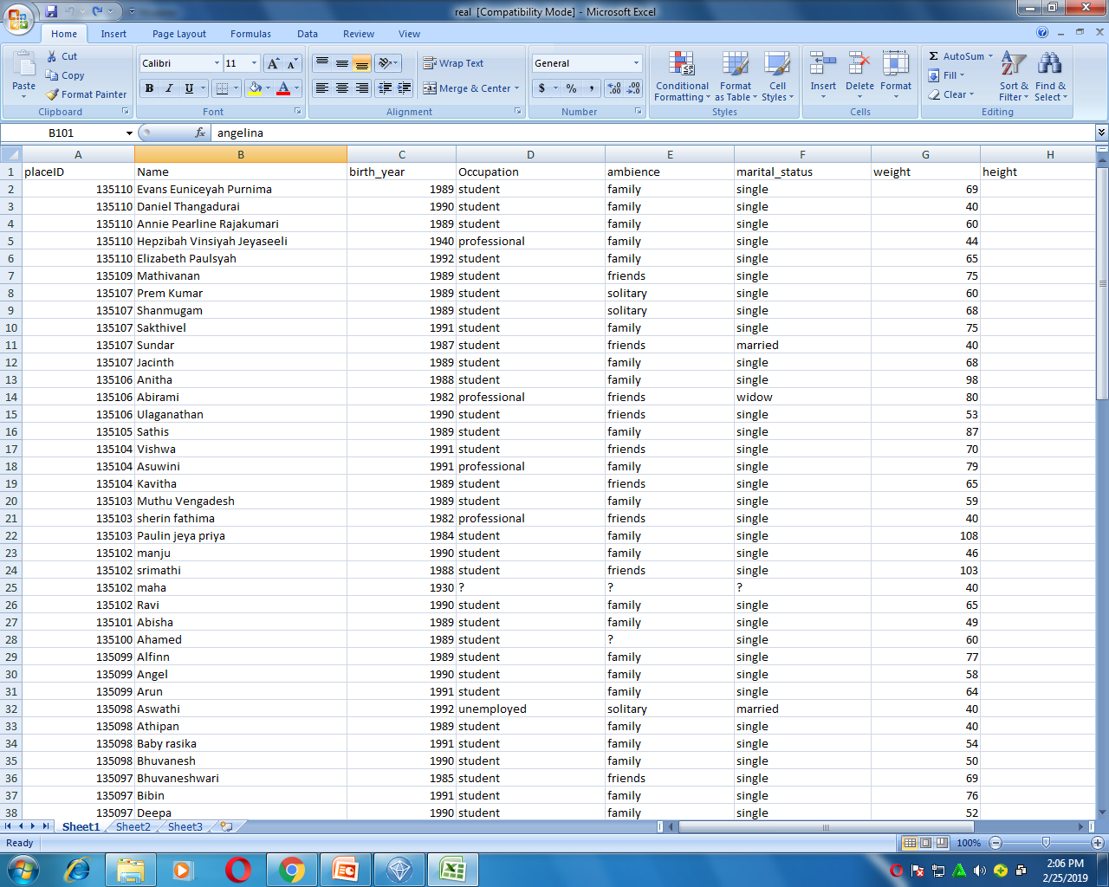
Dataset

Slide 8
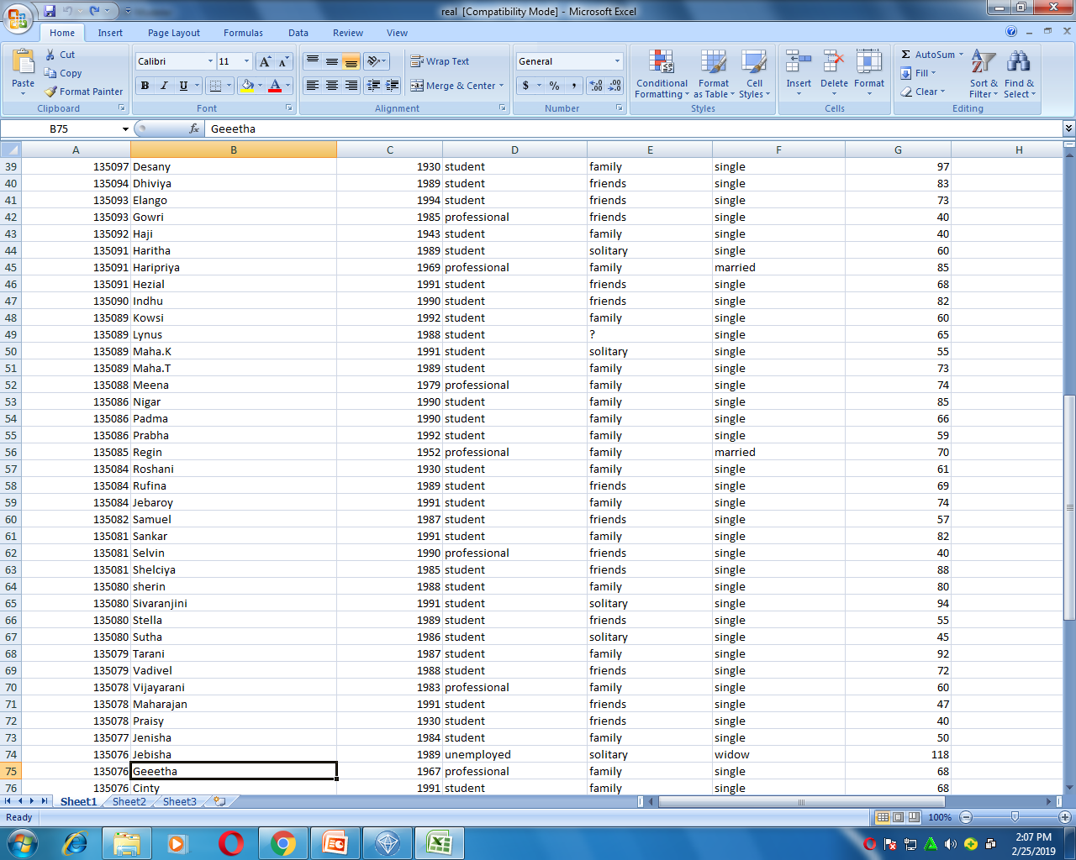

Slide 9
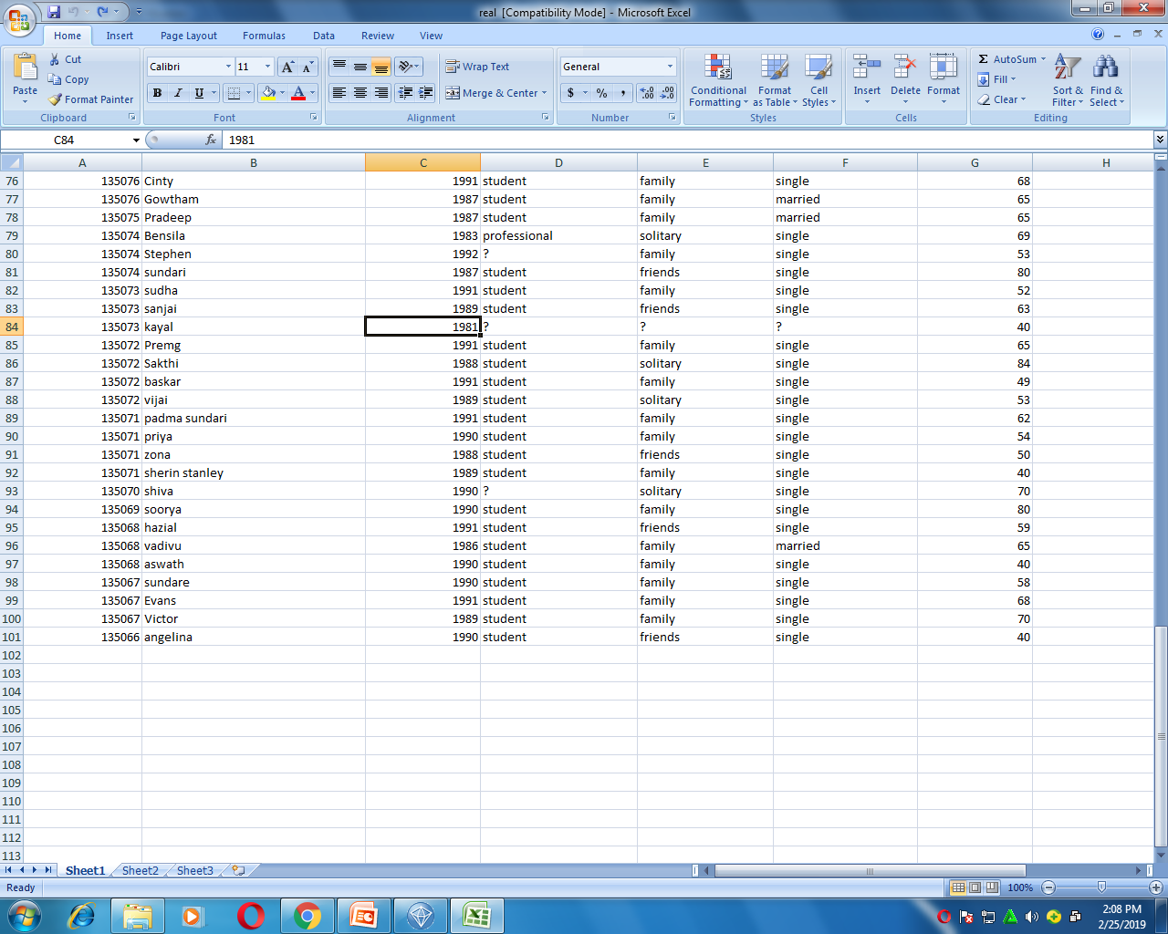

Slide 10
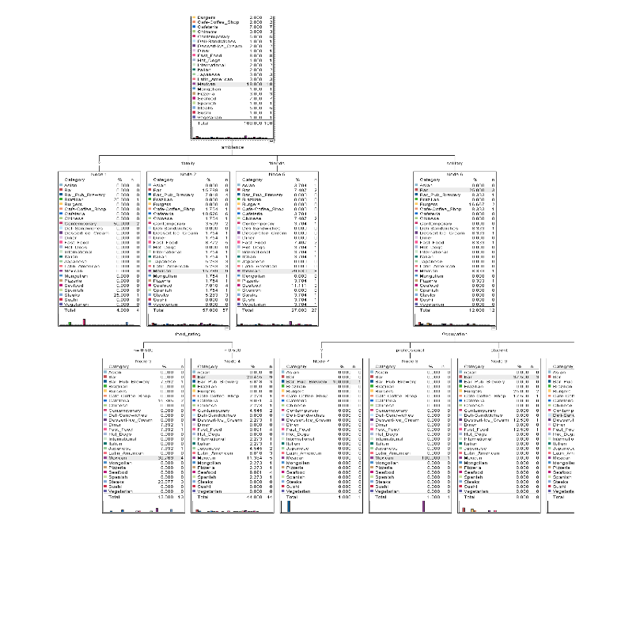
Sample Outcome

Slide 11
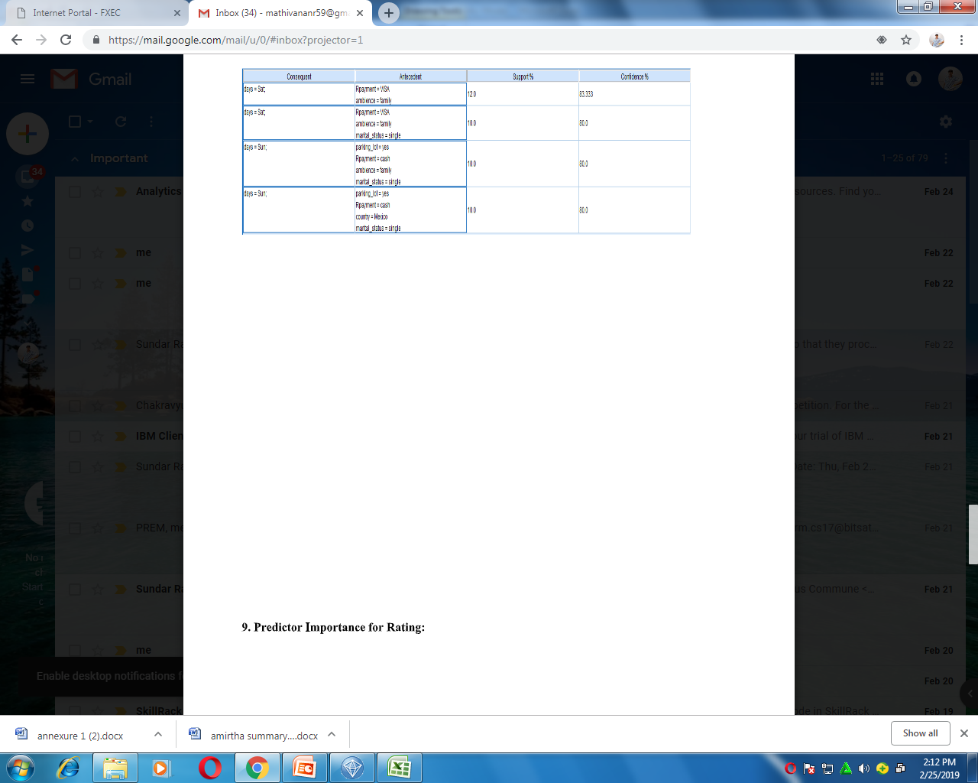

Slide 12
Conclusion
Our business will help clients from various small-scale business to recover from crisis and to develop their business. It will have good social impact to encourage entrepreneurs and resolve unemployment opportunities.

